Slide 1
{INSERT YOUR COMPANY NAME OR LOGO OR EXCITING
IMAGE HERE}
Autumn 2024 School Visit
in collaboration with the
Automotive 30% Club
Notes:
THIS SLIDE TEMPLATE IS TO ASSIST A 30 MINUTE PRESENTATION, WITH 5 MINUTE Q&A AND 5 MINUTE EVALUATION
INTRODUCTION SLIDES – slides 1.2.3.4 = 5 minutes
THIS GIRL IS ME STORY – slide 5 = 5 minutes
YOUR FUTURE SELF – slide 6 = 5 minutes
COMPANY CAREERS INFO – slide 7 = 10 minutes
QUIZ – slide 8 = 5 minutes
Q&A = 5 minutes
EVALUATION = 5 minutes

Slide 2
{Insert your company logo here}
{Insert Headshot of Volunteer in a
professional setting}
{Insert Name}
{Insert Job Title}
{Insert Work Location}
Automotive 30% Club

Slide 3
{Insert your company logo here}
This slide can be used to list some key facts
about your business. You may wish to also show a short promotional video (no more than 2 minutes)
Automotive 30% Club

Slide 4
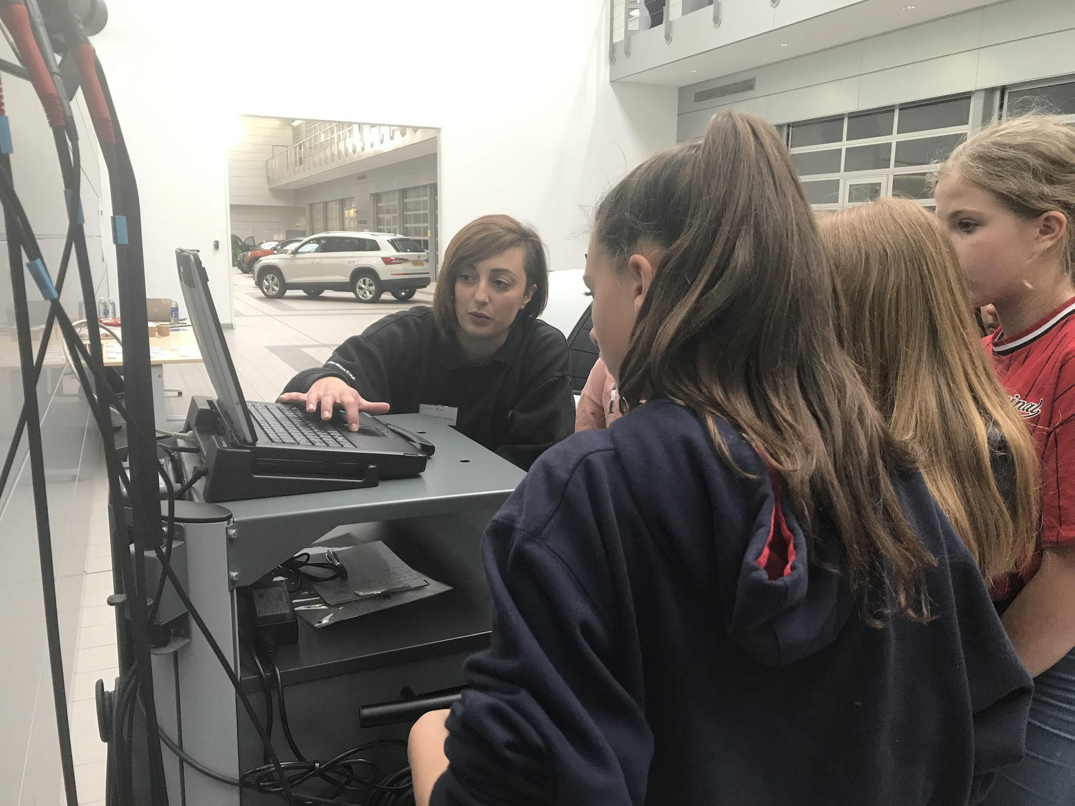
Automotive 30% Club
The Automotive 30% Club was founded in 2016 by Julia Muir, with the purpose of making the automotive a great place for women to work and filling 30% of leadership positions with women by 2030.
An important part of this strategy is to enable girls in schools to meet women in the automotive industry, because “if they can see it, they can be it”.
We now have 71 companies in the Club.

Slide 5
{Insert here a photograph of the volunteer - as a teenager if visiting a secondary school, and younger if a primary school.}
Remember to reveal that “this girl is me” before you talk about what you do in your job now. Then include this year’s theme “I would thank this girl (my younger self) for doing XXX, because that has made me the successful woman I am today”.
Notes:
The volunteer speaks about the girl in the photo as though she is a third party – “she didn’t know which GCSE subjects to take, she was often told off for talking too much etc etc) Then at the end of her story, she reveals that “This girl is me” – and explains that she overcame all the challenges she faced and is now enjoying a successful career in the automotive sector. The volunteer also then includes the key theme for this year and says “ I would thank this girl - my younger self – for doing XXX, because that has made me the successful woman I am today”. Make sure the volunteer covers in her talk the answers to the questions about her that are included in the later quiz.

Slide 6
What do you think your future
self would thank you for doing?
Automotive 30% Club
Notes:
Pose the question, but quickly give examples ( and don’t really expect they can give an answer – it’s more to provoke the thinking process in them) you could tee up the school representative to help with any class discussion here – or ask them to do some preparation in advance.
Secondary school level examples you could give include:
Your future self is a world famous climate change scientist and you thank yourself for choosing triple rather than double science
Your future self is an apprentice or at university, and you thank yourself for trying hard and getting Grade 6s in your English and Maths GCSEs
You future self is a car designer and you thank yourself of choosing Design Technology GCSE
Primary school examples could be:
Your future self is a an author of children’s stories, and your thank yourself for improving your reading and writing ability and reading lots of books
Your future self is a footballer and you thank yourself for going to all the training sessions even when you felt tired and it was raining
Your future self is a business person, and you thank yourself for trying hard and improving your maths
Your future self is a vet, and you thank yourself for taking care of your dog and taking her for walks because that’s what made you love animals

Slide 7
{Embed a film or insert and talk through information about early careers opportunities in your company here.
IT IS VERY IMPACTFUL TO SHOW A PROP THAT IS RELEVANT TO YOUR ROLE / THE BUSINESS e.g a tool, part of a car, PPE, an award / trophy}
Make sure you cover the answers to the questions about your company that are in the following quiz
Notes:
Introduce the video or company info by saying “let’s show you more about the jobs at my company” Use the prop to highlight a key interesting aspect, e.g. the changes due to electrification, the training programmes, or how your company excels and wins awards.
Please say before the video that “there will be a quiz afterwards, so do take notes and listen carefully!”

Slide 8
QUIZ
What is my job title?
Why did I choose to work in the automotive sector?
What do I like best about my job?
What does my company do?
Name a job role available in our company for school leavers.
What would I thank my younger self for doing?
Automotive 30% Club
Notes:
Conduct the quiz in a fast paced and fun way. Give each student who answers a question a treat / freebie.

Slide 9
{Insert your company logo here}
It was great to meet you!
What Questions Do You Have?
Automotive 30% Club
Notes:
Volunteer asks for any questions. At the end of the second session explain that we need the girls to complete the evaluation sheet by putting a sticker on it in the appropriate box. Each girl will be able to choose a biscuit/cake/merchandise when they have put their sticker on.

